Slide 1
CS60055: Ubiquitous Computing
Location, Gesture and Activity Sensing
Part III: Rethinking the Fundamentals

Slide 2
What Fundamentals We Have Learnt So Far?
Orientation is more reliable than location when measured over the IMU
  Orientation is computed separately from Accelerometer, Gyroscope and Magnetometer, and a complimentary filter/ Kalman filter helps reduce the noise
  To compute location, double integration over acceleration is a bad idea! We need to look for alternate methods

Slide 3
What Fundamentals We Have Learnt So Far?
Orientation is more reliable than location when measured over the IMU
  Orientation is computed separately from Accelerometer, Gyroscope and Magnetometer, and a complimentary filter/ Kalman filter helps reduce the noise
  To compute location, double integration over acceleration is a bad idea! We need to look for alternate methods
However, the basis of orientation calculation is the "gravity"
  Assumption: The value and the direction of the gravitational acceleration is a known constant (9.81 m/s² towards the downward Z-axis in ECS which we assume as the Global Reference Frame or GRF)
  For a stationary object with respect to the ECS, we can "observe" the X, Y and Z components of this acceleration (through the accelerometer) and then use the Euler Angle method to compute the orientation

Slide 4
What Fundamentals We Have Learnt So Far?
When the object is in motion, we can apply one of the two techniques
  Compute the initial orientation of the object (when it is static), and then integrate the gyroscope data to obtain subsequent orientations
  Periodically recalibrate the orientation, when the object pauses in between
Based on the predicted 3D orientation of the object, project the proper acceleration of the object on the target reference frame after subtracting the gravity offset, and then double integrate to get the location in 3D
  However, double integrate may induce significant amount of noise in the estimation, so we have seen alternate methods

Slide 5
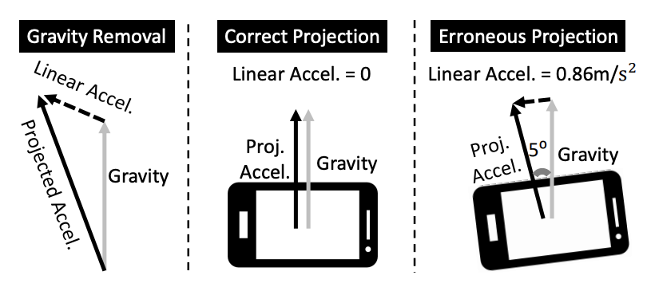
Is Gravity A Good Anchor in Real World?
Gravity Pollution
  Accelerometer can use gravity only when it is static; otherwise, the object's motion will mix with the gravity measurement
Magnetic Interference
  From accelerometer, we cannot measure
  yaw, we need magnetometer
  However, nearby ferromagnetic materials
  may pollute magnetometer readings
Inherent Sensor Noise
  Hardware noise is always there in the measurements, any integration (even a single integration over gyroscope) will accumulate noise

Slide 6
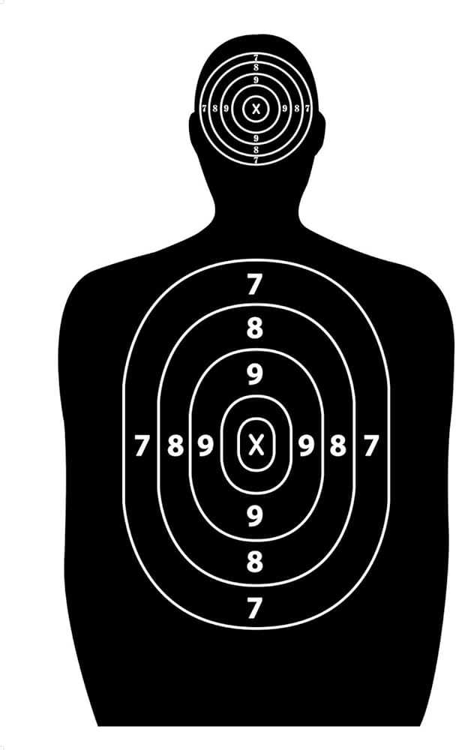
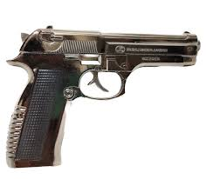

Orientation is Crucial for Location Measurement of a Moving Object

Slide 7
Orientation is Crucial for Location Measurement of a Moving Object

Slide 8
When Can We Use Gravity as an Anchor
Gravity is unpolluted when
  The object is static
  The object has pure rotational motion
Find out the instances when the gravity is unpolluted and recalibrate the GRF to LRF mapping during those instances
  Check the A³ paper*
However, such instances are rare in many of the real scenarios
  Say, the person is running
*P. Zhou, M. Li, and G. Shen, “Use it free: Instantly knowing your phone attitude,” in ACM MobiCom 2014

Slide 9
When Can We Use Gravity as an Anchor
Gravity is unpolluted when
  The object is static
  The object has pure rotational motion
Find out the instances when the gravity is unpolluted and recalibrate the GRF to LRF mapping during those instances
  Check the A³ paper*
However, such instances are rare in many of the real scenarios
  Say, the person is running
Can we figure out a better anchor than gravity?
*P. Zhou, M. Li, and G. Shen, “Use it free: Instantly knowing your phone attitude,” in ACM MobiCom 2014

Slide 10

Towards a Better Anchor for Motion Tracking using IMU
ACM MobiCom 2018

Slide 11
Orientation Estimation
Can you think of any other feature which is fixed in the global reference frame and can be measured using the IMU?

Slide 12
Orientation Estimation
Can you think of any other feature which is fixed in the global reference frame and can be measured using the IMU?
  3D Magnetic North Vector
Pros: The magnetometer reading does not vary with linear acceleration
Cons: The intensity and direction may vary across locations

Slide 13
Orientation Estimation
Can you think of any other feature which is fixed in the global reference frame and can be measured using the IMU?
  3D Magnetic North Vector
Pros: The magnetometer reading does not vary with linear acceleration
Cons: The intensity and direction may vary across locations
Key idea: The object starts from a static moment, utilizes the unpolluted gravity to precisely estimate the 3D North vector, and thereafter uses the North vector as the anchor for orientation

Slide 14
The Initialization
Accelerometer
  Offers unpolluted gravity during initialization (when the object is static)
  Determine the vertical tilt of the object (roll, pitch)
Magnetometer
  Measures the 3D magnetic vector in the local reference frame (LRF)
  Project the computed magnetic vector to the horizontal plane to estimate the object's heading (yaw)
Combine these two to determine the 3D orientation of the object in the GRF

Slide 15

Towards the New Anchor
Once we know the initial 3D orientation (O(t₀)) of the object,
  Project the current magnetometer's local measurement (N^{L}(t₀))onto the GRF
  Leads the global 3D magnetic north vector N^{G}
Gives the anchor we need,

Slide 16
Towards the New Anchor
Once we know the initial 3D orientation (O(t₀)) of the object,
  Project the current magnetometer's local measurement (N^{L}(t₀))onto the GRF
  Leads the global 3D magnetic north vector N^{G}
Gives the anchor we need,
As the object starts moving, the magnetometer tracks N^{G} in its LRF
  Provides 2 DoF of global orientation
In parallel, gyroscope tracks all 3 DoFs of changing orientation
  But the values can be polluted due to the motion of the object
How can we combine the 5 DoFs to accurately measure the 3-DoF orientation?

Slide 17
Magnetometer + Gyroscope Fusion
Gyroscope drift accumulates over time -> Use magnetometer to recalibrate
  Gyroscope measures changes in 3-DoF orientation
  Magnetometer measures 2-DoF of global orientation

Slide 18

Magnetometer + Gyroscope Fusion
Gyroscope drift accumulates over time -> Use magnetometer to recalibrate
  Gyroscope measures changes in 3-DoF orientation
  Magnetometer measures 2-DoF of global orientation
Assume that at current time t, the actual orientation of the object is O(t)
  O(t) is a 3x3 rotation matrix that rotates the object's GRF to LRF
Since, the magnetometer measure the global 3D magnetic North vector N^{G} in its LRF,
  Note that we do not know the actual O(t), and the current measure from gyroscope O'(t) is erroneous.

Slide 19
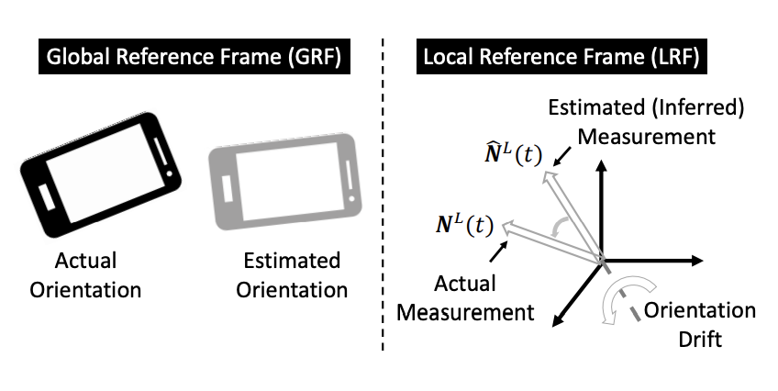
Magnetometer + Gyroscope Fusion
However, we can check this error by computing the N'^{L}(t) and comparing it with N^{L}(t),
N'^{L}(t) = O'⁻¹(t)N^{G}
The difference between the actual magnetometer measurement (N^{L}(t)) and the computed measurement (N'^{L}(t)) reveals the drift in the orientation

Slide 20
Magnetometer + Gyroscope Fusion
However, we can check this error by computing the N'^{L}(t) and comparing it with N^{L}(t),
N'^{L}(t) = O'⁻¹(t)N^{G}
The difference between the actual magnetometer measurement (N^{L}(t)) and the computed measurement (N'^{L}(t)) reveals the drift in the orientation
How do we update orientation estimation using this disparity?

Slide 21
Updating Orientation
Key observation: Noise properties of magnetometer and gyroscope are different
  Gyroscopes observe a long-term integration drift (measures angular velocity in its LRF and compute the orientation based on calculating the angular displacement from the measured angular velocity)
    However, it is quite accurate in short-term
  Magnetometers have short-term noise from environmental fluctuations and sensor imperfection
    However, do not drift in the long run as they always measure the same global North vector and thus no integration is needed.

Slide 22
Updating Orientation
To fuse the best of both sensors, a complimentary filter is used
  Computes the weighted combination of the two
Gyroscope drifts less in the short term
  Extract the high frequency components from the gyroscope
Magnetometer is stable in long run
  Extract the low frequency components from the magnetometer
Assign larger weight to the gyroscope

Slide 23
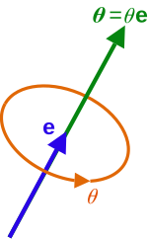
Updating Orientation
To fuse the best of both sensors, a complimentary filter is used
  Computes the weighted combination of the two
Gyroscope drifts less in the short term
  Extract the high frequency components from the gyroscope
Magnetometer is stable in long run
  Extract the low frequency components from the magnetometer
Assign larger weight to the gyroscope
MUSE uses axis-angle rotations rather than Euler angle rotation! Why?

Slide 24
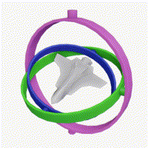
Gimbal Lock
A scenario when you lose one degree of freedom
  When the axis of two of the gimbals become
  parallel
  The third axis cannot make any further progress
Depends on how you are triggering the Euler
angles rotation
  Need a fourth gimbal to manually break the lock
Popular incident: Apollo 11 moon mission
  The spacecraft had been manually operated to
  come out of the lock, using starts as reference
  Mike Collins: "How about sending me a fourth gimbal for Christmas?"
Image Source: Wikipedia

Slide 25
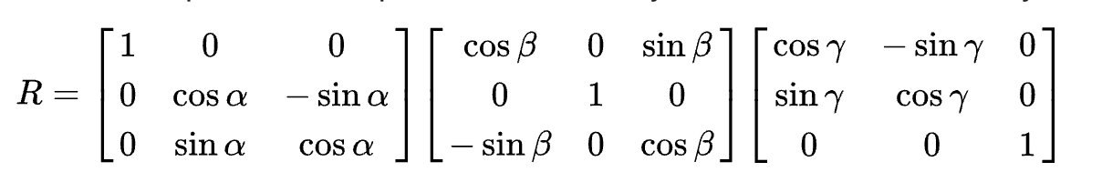
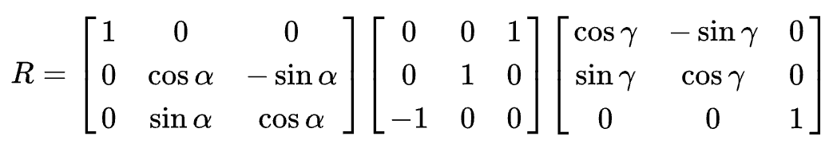
Gimbal Lock: An Example
Direction Cosine Matrix for 3-2-1 Euler angles:
Let β = π/2, then

Slide 26
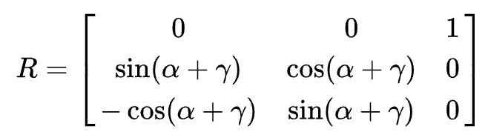
Gimbal Lock: An Example
Performing matrix multiplication and applying the trigonometry formula:
Changing the values of 𝛼 and 𝛾 in the above matrix has the same effects
  The rotation angle (𝛼+𝛾) changes
  The rotation axis remains in the Z direction (the first row and the last column remains fixed with all values of 𝛼 and 𝛾)
MUSE uses axis angles rather than Euler angles to avoid such Gimbal locaks.

Slide 27
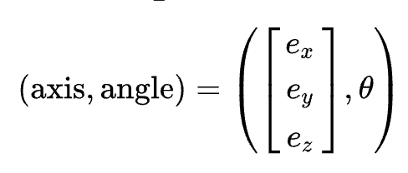
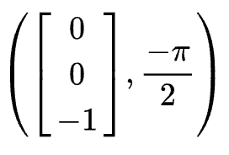

Why Axis Angle Does Not Suffer from Gimbal Lock?
Represented as an ordered pair
Say, a π/2 left rotation while standing:
Equivalent Euler angle representation:

Slide 28
Why Axis Angle Does Not Suffer from Gimbal Lock?
Represented as an ordered pair
Say, a π/2 left rotation while standing:
Equivalent Euler angle representation:
Axis angle represents the rotations with respect to each individual axes, whereas Euler angle provides rotation with respect to each previous rotations, make them locked when no movement possible with respect to the previous rotation

Slide 29
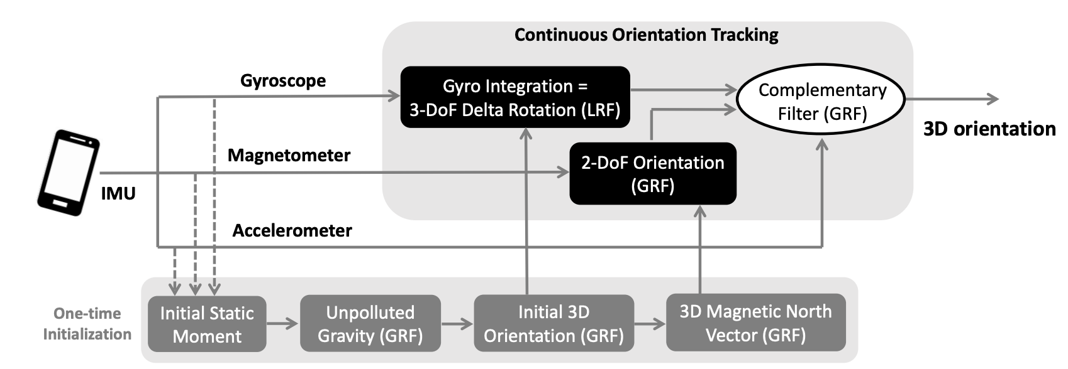
MUSE Processing Pipeline

Slide 30
Some Interesting Issues
MUSE calibrates 2 DoF using the magnetic north poles; however, it cannot correct the error for the other DoF when in motion.
  Opportunistically detects static or slow-moving instances to recalibrate that DoF

Slide 31
Some Interesting Issues
MUSE calibrates 2 DoF using the magnetic north poles; however, it cannot correct the error for the other DoF when in motion.
  Opportunistically detects static or slow-moving instances to recalibrate that DoF
When does MUSE fail?

Slide 32
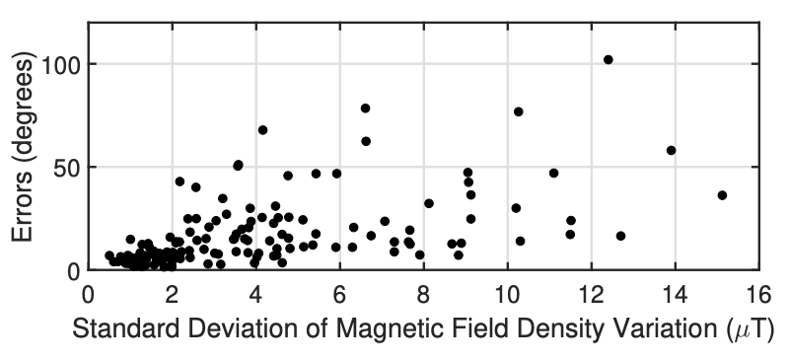
Some Interesting Issues
MUSE calibrates 2 DoF using the magnetic north poles; however, it cannot correct the error for the other DoF when in motion.
  Opportunistically detects static or slow-moving instances to recalibrate that DoF
When does MUSE fail?
  Rotation is only across the 3rd DoF (the global anchor – magnetic north axis)
  No opportunity for initialization
  Strong magnetic interference

Slide 33
Location Estimation
ArmTrak provided a method for estimating location from orientation using 5 DoFs of arm's kinematics
  What can be the possible issue with such a system?

Slide 34
Location Estimation
ArmTrak provided a method for estimating location from orientation using 5 DoFs of arm's kinematics
  What can be the possible issue with such a system?
Orientation estimation with each DoF introduces divergence
  The error margin may get expanded due to the divergence with each of the 5 DoFs
In practical sense, orientation and locations are coupled with each other
  There would be a location change with each of the orientation change (unless the orientation change is solely on one axis)
  Can we develop a joint orientation and location tracking approach?

Slide 35
The Core Idea
MUSE estimates the orientation of the IMU sensors
  Among the 3 DoF orientation, two of them will be drift free
  We need to estimate the remaining 1 DoF orientation and 2 DoFs of location from the 3 DoF accelerometer

Slide 36
The Core Idea
MUSE estimates the orientation of the IMU sensors
  Among the 3 DoF orientation, two of them will be drift free
  We need to estimate the remaining 1 DoF orientation and 2 DoFs of location from the 3 DoF accelerometer
What sequence of watch orientations and locations will cause gravity and linear motion to (vectorially) add up in a way that matches the accelerometer measurements?

Slide 37
The Core Idea
MUSE estimates the orientation of the IMU sensors
  Among the 3 DoF orientation, two of them will be drift free
  We need to estimate the remaining 1 DoF orientation and 2 DoFs of location from the 3 DoF accelerometer
What sequence of watch orientations and locations will cause gravity and linear motion to (vectorially) add up in a way that matches the accelerometer measurements?
Use a particle filtering-based approach to combine them together for a joint estimation of location and orientation

Slide 38
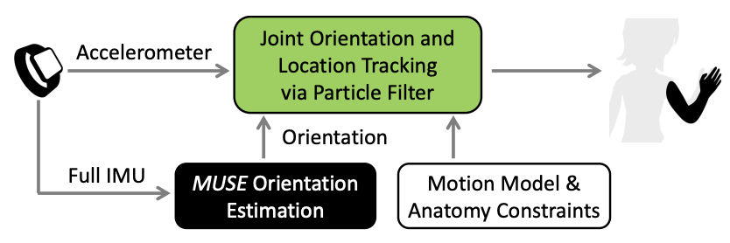
MUSE Location Estimation

Slide 39
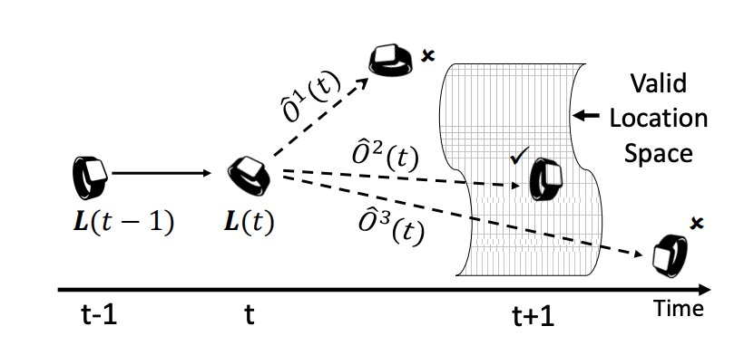
Joint Tracking through Particle Filter
We have certain uncertainty in the orientation estimation
  Possible drift in the 1-DoF towards magnetic north
  However, different orientation may project to different locations
The correct estimation of the
orientation will project the location
within the valid location space
Challenge: In reality, the past locations
are not knows and needs to be estimated
  The valid location space depends on the smartwatch orientation – a nonlinear system

Slide 40
Joint Tracking through Particle Filter
Model each possible <orientation, location> trajectory as a particle in the particle filter
  Particles with wrong orientation will exhibit
  diminishing weights and will eventually
  get removed
  Particles that are left behind are likely
  to be the good joint estimators for
  both location and orientation

Slide 41
Statistical Filters – A Primer
Use a series of observed measurements over time to predict unknown variables, while considering statistical noises and other measurement inaccuracies
Kalman Filter
  a.k.a Linear quadratic estimation (estimates state of a linear dynamic system)
  The filter uses a system's dynamic model (such as, the laws of motion), known control inputs to that system, and multiple sequential measurements (such as from sensors) to form an estimate of the system's varying quantities (its state)
    Expected to be better than the estimate obtained by using only a single measurement.
  Estimate a joint probability distribution over the variables for each time frame
  Constructed as a mean squared error minimizer
  A recursive filter (uses the output to its input)
  Various variations exist: Simple Kalman Filter, Kalman-Bucy Filter, Information filter, …

Slide 42


Kalman Filtering
Assumes that the true state at time k evolves from the state (k-1)
  F_{k} is the state transition model applied to the previous state x_{k-1}
  B_{k} is the control-input model applied to the control vector u_{k}
  w_{k} is the process noise, assumed to be drawn from a zero-mean multivariate normal distribution with covariance Q_{k} (which also needs an estimate from the observations)
At time k, an observation of the true state is estimated as,
  H_{k} is the observation model, maps the true state space to the observed state space
  v_{k} is the observation noise, assumed to be zero-mean Gaussian white noise

Slide 43
Kalman Filtering
Inputs:
  Measurements: mx1 vector
  Measurement Covariance matrix: mxm matrix
System Model:
  State transition matrix: nxn matrix
  State-to-measurement matrix: mxn matrix
  Process noise covariance matrix: nxn matrix
Internal Parameter:
  Kalman Gain: nxm matrix (the weight given to the measurements and current-state estimate)
Output:
  State variable: nx1 vector
  State Covariance matrix: nxn matrix

Slide 44
Kalman Filtering
Measurement 1
Initialize system state estimate and system state error covariance
Measurement 2
Reinitialize system state estimate and system state error covariance
Measurement 3+
Predict system state and system state error covariance till the measurement time
Compute the Kalman Gain
Estimate system state and system state error covariance till the measurement time

Slide 45
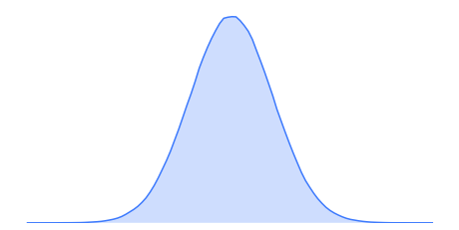

Kalman Filter: Example
PDF
Position (p)
Estimate at k-1

Slide 46
Kalman Filter: Example
PDF
Prediction
Position (p)
Estimate at k-1
Apply motion model (say, odometry) for predicting the position at k

Slide 47
Kalman Filter: Example
PDF
Measurement
Prediction
Position (p)
Apply motion model (say, odometry) for predicting the position at k
Measure the observed location of the car at time k (say, by GPS)
Estimate at k-1

Slide 48
Kalman Filter: Example
PDF
Fusion
Measurement
Prediction
Position (p)
Apply motion model (say, odometry) for predicting the position at k
Measure the observed location of the car at time k (say, by GPS)
Estimate at k-1
Estimate the position at k which is noise-free

Slide 49
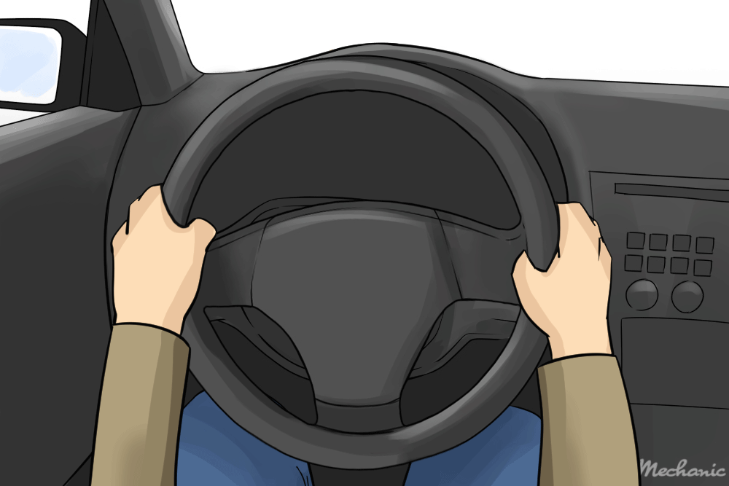
Extended Kalman Filters (EKF)
The simple Kalman filters use a linearity assumption in the state transition model F_{k} and the observation model H_{k}
  Good for many applications
  But not all applications can be modeled using liner motion
Can we approximate a non-linear motion
to a linear motion?

Slide 50
Extended Kalman Filters (EKFs)
EKFs overcome the linearity assumptions
  Considers that the next state probability and the measurement probabilities are giverned by non-linear functions g and h as,
  x_{k} = g(u_{k}, x_{k-1}) + ε_{k}
  z_{k} = h(x_{k}) + δ_{k}
  where g and h are any arbitray function, and ε and δ are the process noise and observation noise
However, with arbitrary functions, we cannot assume that the noises are drawn from a Gaussian distribution
  We need a linear approximation of the functions

Slide 51
Extended Kalman Filters (EKFs)
EKFs overcome the linearity assumptions
  Considers that the next state probability and the measurement probabilities are giverned by non-linear functions g and h as,
  x_{k} = g(u_{k}, x_{k-1}) + ε_{k}
  z_{k} = h(x_{k}) + δ_{k}
  where g and h are any arbitray function, and ε and δ are the process noise and observation noise
However, with arbitrary functions, we cannot assume that the noises are drawn from a Gaussian distribution
  We need a linear approximation of the functions
How can we approcimate g and h to a linear function?

Slide 52
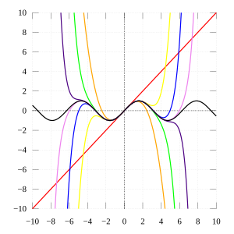
Extended Kalman Filters (EKF)
Apply Taylor expansion to get a linear approximation of the function at any measurement point
Use the partial derivative to get the slope:
g'(u_{k} , x_{k-1}) := ∂g(u_{k}, x_{k-1})/∂x_{k-1}
We can approximate g using the Taylor expansion
as follows:
g(u_{k} , x_{k-1}) ≈ g(u_{k} , μ_{k-1}) + g'(u_{k} , μ_{k-1})(x_{k-1} - μ_{k-1})
where g'(u_{k} , μ_{k-1}) is g'(u_{k} , x_{k-1}) evaluated at x_{k-1} = μ_{k-1}

Slide 53
Extended Kalman Filters (EKF)
We can approximate g using the Taylor expansion
as follows:
g(u_{k} , x_{k-1}) ≈ g(u_{k} , μ_{k-1}) + g'(u_{k} , μ_{k-1})(x_{k-1} - μ_{k-1})
where g'(u_{k} , μ_{k-1}) is g'(u_{k} , x_{k-1}) evaluated at x_{k-1} = μ_{k-1}
u_{k} is a constant here (based on the measurement
-- the point at which you compute the slope),
μ_{k-1} is also a constant. So, the first term returns a
constant value
  The approximation returns a linear function of x_{k-1}

Slide 54
Extended Kalman Filters (EKF)
We define G_{k} = g'(u_{k} , μ_{k-1}) (the Jacobian matrix of size n x n)
Then the approximation is represented as follows:
g(u_{k} , x_{k-1}) ≈ g(u_{k} , μ_{k-1}) + G_{k}(x_{k-1} - μ_{k-1})
So, we can approximate the next state probability as follows:
p(x_{k}|u_{k}, x_{k-1}) := N(g(u_{k} , μ_{k-1}) + G_{k}(x_{k-1} - μ_{k-1}), Q_{k})

Slide 55
Extended Kalman Filters (EKF)
Similarly, we approximate
h(x_{k}) ≈ h(μ'_{k}) + h'(μ'_{k})(x_{k} - μ'_{k})
h(x_{k}) ≈ h(μ'_{k}) + H_{k}(x_{k} - μ'_{k})
where μ'_{k} is the state that is most likely at the time of linearizing h
Finally, the measurement probability is approximated as:
z_{k} := N(h(μ'_{k}) + H_{k}(x_{k} - μ'_{k}), R_{k})

Slide 56
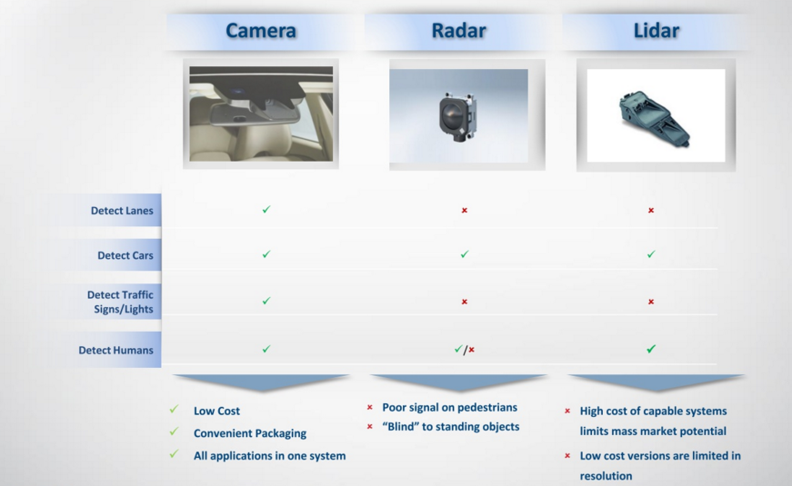
Example: Tracking Vehicle Movements
Source: https://junshengfu.github.io/tracking-with-Extended-Kalman-Filter/

Slide 57
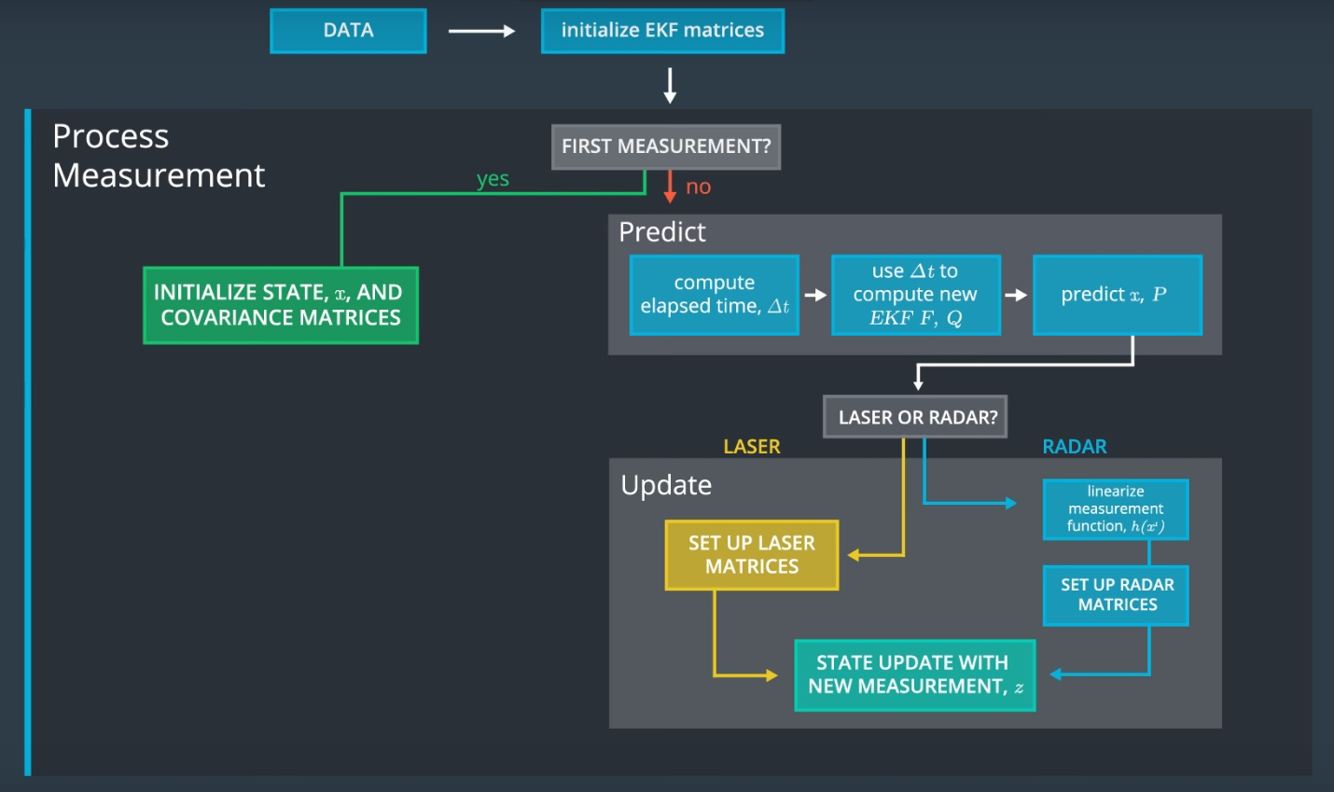
Example: Tracking Vehicle Movements
Source: https://junshengfu.github.io/tracking-with-Extended-Kalman-Filter/

Slide 58
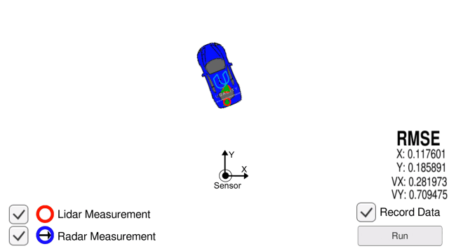
Example: Tracking Vehicle Movements
Source: https://junshengfu.github.io/tracking-with-Extended-Kalman-Filter/

Slide 59
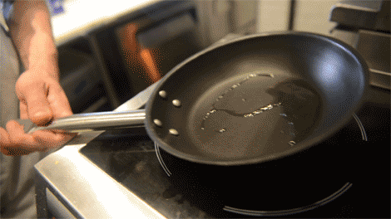
Particle Filters
Non-parametric filters: The representation of the state space is represented as a set of samples drawn from the underlying distribution
  Remember that Kalman Filter uses a parametric form – use a function based on Gaussian distribution to model the state space
  However, a function may not represent all possible samples in a state space, particularly when the state space is not based on some known form, like Gaussian

Slide 60
Particle Filters
Non-parametric filter: The representation of the state space is represented as a set of samples drawn from the underlying distribution
  Remember that Kalman Filter uses a parametric form – use a function based on Gaussian distribution to model the state space
  However, a function may not represent all possible samples in a state space, particularly when the state space is not based on some known form, like Gaussian
f

Slide 61
Particle Filters
Non-parametric filter: The representation of the state space is represented as a set of samples drawn from the underlying distribution
  Remember that Kalman Filter uses a parametric form – use a function based on Gaussian distribution to model the state space
  However, a function may not represent all possible samples in a state space, particularly when the state space is not based on some known form, like Gaussian
Rather than maintaining a set of parameters for the distribution (i.e., mean, covariance), the particle filter stores a set of samples that represent the distribution!
f

Slide 62
Particle Filters
The samples drawn from the distribution are called the particles:
X_{k} = x_{k}^{[1]}, x_{k}^{[2]}, …, x_{k}^{[M]}
Each particle represents a hypothesis (a guess) that what the true world state might be at time k given the observations z and the actions u,
x_{k}^{[m]} ~ p( x_{k} | z_{1:k} , u_{1:k} )
As M → ∞, the denser a sub-region of the state space is populated by the samples drawn, the more likely that the true state falls within this expected sub-region

Slide 63
Particle Filter Algorithm
Input: χ_{k-1}, u_{k}, z_{k}
Initialize χ'_{k} = χ_{k} = ∅
For m=1 to M, do
  Sample x_{k}^{[m]} ~ p(x_{k} | u_{k}, x_{k-1}^{[m]})
  ω_{k}^{[m]} = p(z_{k}|x_{k}^{[m]})
  χ'_{k} = χ'_{k} + <x_{k}^{[m]}, ω_{k}^{[m]}>
For m=1 to M, do
  draw i with probability proportional to ω_{k}^{[i]}
  Add x_{k}^{[i]} to χ_{k}
Return χ_{k}
Draw the initial set of particles based on the belief distribution; however, based on the observations, some particles might have a very low probability

Slide 64
Particle Filter Algorithm
Input: χ_{k-1}, u_{k}, z_{k}
Initialize χ'_{k} = χ_{k} = ∅
For m=1 to M, do
  Sample x_{k}^{[m]} ~ p(x_{k} | u_{k}, x_{k-1}^{[m]})
  ω_{k}^{[m]} = p(z_{k}|x_{k}^{[m]})
  χ'_{k} = χ'_{k} + <x_{k}^{[m]}, ω_{k}^{[m]}>
For m=1 to M, do
  draw i with probability proportional to ω_{k}^{[i]}
  Add x_{k}^{[i]} to χ_{k}
Return χ_{k}
Importance Resampling
Resample the particles based on the probability: The particles having higher probability gets more number of instances, whereas the particles with very low probability vanishes

Slide 65
Particle Filter Algorithm
Input: χ_{k-1}, u_{k}, z_{k}
Initialize χ'_{k} = χ_{k} = ∅
For m=1 to M, do
  Sample x_{k}^{[m]} ~ p(x_{k} | u_{k}, x_{k-1}^{[m]})
  ω_{k}^{[m]} = p(z_{k}|x_{k}^{[m]})
  χ'_{k} = χ'_{k} + <x_{k}^{[m]}, ω_{k}^{[m]}>
For m=1 to M, do
  draw i with probability proportional to ω_{k}^{[i]}
  Add x_{k}^{[i]} to χ_{k}
Return χ_{k}
Particles which are more likely to represent the true state gets duplicated whereas the particles that has very low probabilities get vanished from the system!

Slide 66
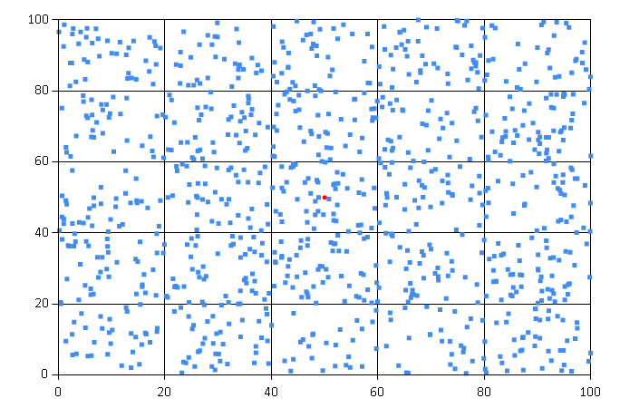
Particle Filter - Visualization
Source: https://towardsdatascience.com/particle-filter-a-hero-in-the-world-of-non-linearity-and-non-gaussian-6d8947f4a3dc

Slide 67

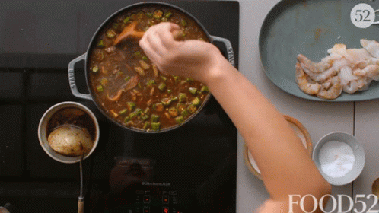
Particle Filters: An Example

Slide 68
Particle Filters: An Example

Slide 69
Particle Filters: An Example
Resampling

Slide 70
Particle Filters: An Example
Resampling

Slide 71
Design Challenges of Particle Filters
Number of particles
  Theoretically, the filter approximates true distribution when the number of particles is close to infinity
  In practice, use a large value of M
High variance
  Resampling introduces randomness -> the estimator results in a high variance
  If we resample too frequently, we lose variety in the sample
  Reduce the rate of resampling, or use a low-variance resampler

Slide 72
Design Challenges of Particle Filters
Divergence between proposed and target distribution
  What if the motion model is noisy but the sensors are correct?
  Inherent assumption: The sensors are noisy, and the models are correct!
Particle deprivation
  Particles are sparse in high dimensional space
  Particles near the true state may vanish due to random resampling
  Periodically add a small number of new particles unformly over the space

Slide 73
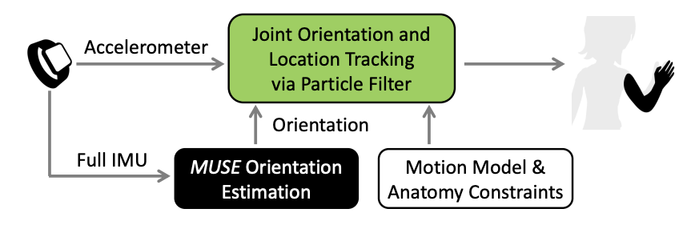
Returning back to MUSE

Slide 74
MUSE Particle Filtering
Particles: <orientation, location>
State Space: three recent location estimates along with the orientation drift around magnetic north vector
Weight update:
  A good estimate of the state should ensure
    It lies in the valid location space
    It matches the accelerometer measurements
  Compare the accelerometer sensor reading with the measured acceleration from particles' locations

Slide 75
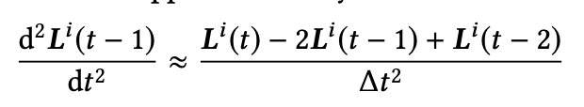

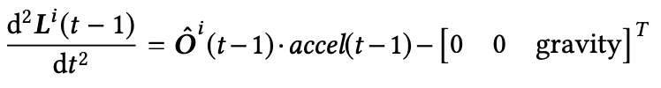
Handling Acceleration and Orientation
From the location of the particles, we can compute the global acceleration as follows:
The accelerometer gives the true acceleration (impact of orientation + the gravitational acceleration)
  MUSE orientation estimation can have a drift; subtract the drift as observed from the magnetic north vector
  Subtract the gravity component to get the global acceleration:

Slide 76
Handling Acceleration and Orientation
From the location of the particles, we can compute the global acceleration as follows:
The accelerometer gives the true acceleration (impact of orientation + the gravitational acceleration)
  MUSE orientation estimation can have a drift; subtract the drift as observed from the magnetic north vector
  Subtract the gravity component to get the global acceleration:
Need to minimize the difference between these two. Assign the particle weight as a zero-mean Gaussian probability density function on these differences

Slide 77
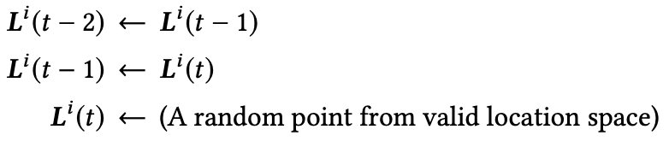
Particle Filter for MUSE
Resampling:
  Resampled at each step to ensure that the particles are more concentrated to the ones with higher probability (better fitted to the accelerometer measurements)
Predictions:
  Takes the average drift collection for all the particles and use it to calibrate MUSE output
  The location triples are updated after each step:

Slide 78
MUSE Particle Filtering
Resampling:
  Resampled at each step to ensure that the particles are more concentrated to the ones with higher probability (better fitted to the accelerometer measurements)
Predictions:
  Takes the average drift collection for all the particles and use it to calibrate MUSE output
  The location triples are updated after each step:
Preserves diversity in the system

Slide 79
In Summary
IMU sensors are never correct
  Even MUSE can suffer from strong magnetic interference
Correction and calibrations are needed depending on application requirements
  Not all applications need high accuracy: Think about the best optimization
  Tradeoff across correctness and real-time performance
We now know how to identify the gestures, how do we indentify activities from the gestures?

Slide 80
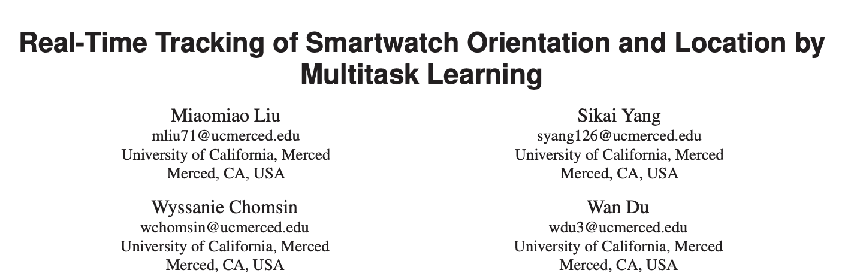
Further Reading
Liu, Miaomiao, et al. "Real-time tracking of smartwatch orientation and location by multitask learning." Proceedings of the 20th ACM Conference on Embedded Networked Sensor Systems. 2022. https://dl.acm.org/doi/pdf/10.1145/3560905.3568548

Slide 81





Happy Learning!
Some resources related to this topic

